Slide 1
Ensemble Learning
By
Rishabh TenGuria
Saurav Kumar
Meenu Yadav

Slide 2
Ensemble Learning:
What?
Why?
How?

Slide 3
Ensemble Learning:
Ensemble Techniques combine individual models together to improve the stability and predictive power of the model.
This technique permits higher predictive performance.
It combines multiple learning models into one predictive model in order to
decrease variance using bagging,
decrease bias using boosting,
improve predictions using stacking.

Slide 4
The ideology behind Ensemble learning:
As we have seen before, certain models do well in modeling one aspect of the data, while others do well in modeling another.
Instead of learning a single complex learning model, learn several simple models and combine their output to produce the final decision.
In Ensemble Learning, the combined strength of the models offsets individual model variances and biases.
This provides a composite prediction where the final accuracy is better than the accuracy of the individual models.

Slide 5
Working:
Ensemble Methods :
Sequential Ensemble Methods:
generates base learners in a sequence, e.g., adaptive boosting (AdaBoost).
The sequential generation of base learners promotes the dependence between the base learners.
The performance of the model is then improved by assigning weights.
2. Parallel Ensemble Methods:
Applied wherever the base learners are generated in parallel, e.g., Random Forest.
The basic motivation is to use independence between the base learners.

Slide 6
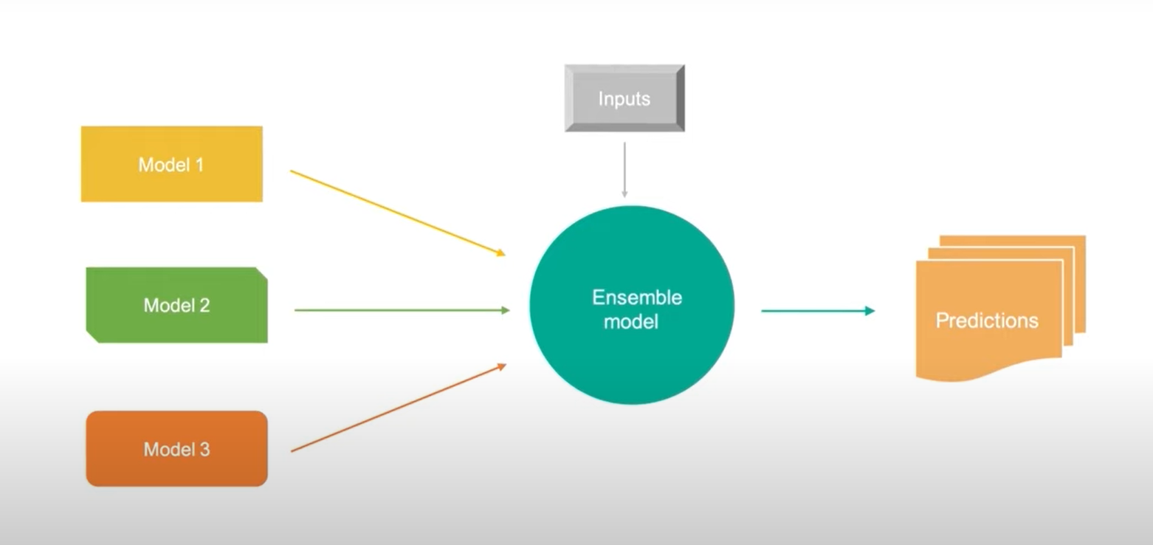
Here in the given diagram, we are using the parallel ensemble method where the different method works best in one or other aspect of data.
They are combined in the ensemble model where the best aspect of each of the models is considered upon the input data and then the ensemble learning method comes up with a prediction.

Slide 7
Ensemble Learning: Significance
Ensemble model is the application of multiple models in order to obtain better performances than from a single model.
Performance depends upon two factors: Robustness and Accuracy.
Robustness: Ensemble models incorporate the predictions from all the base learners.
Accuracy: Ensemble models deliver accurate predictions and have improved performances.

Slide 8
Ensemble Learning Methods:
Boosting:
Combine all the weak learners to form an ensemble.
Ensemble Learning gains more accuracy and robustness by combining data from numerous modeling approaches.
Averaging:

Slide 9
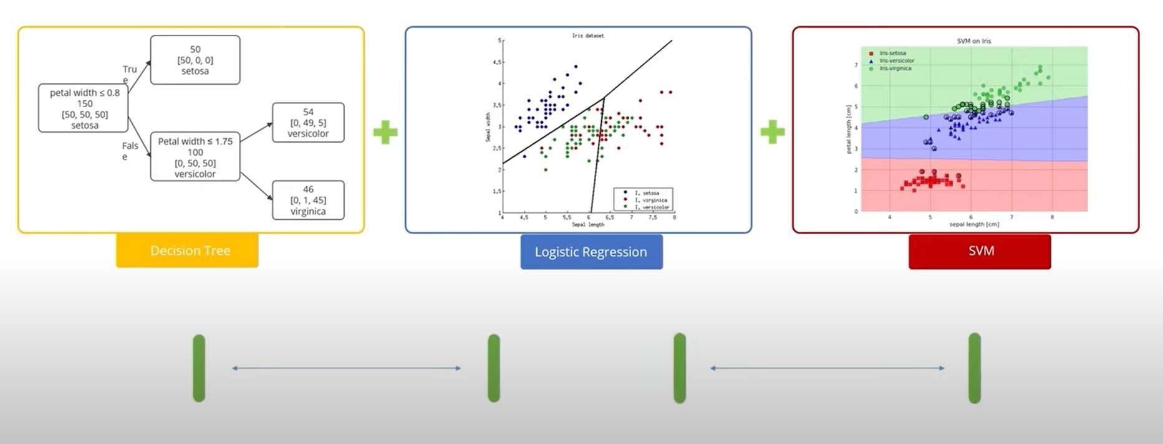
Model averaging is an approach to ensemble learning where each member contributes equal amount to the final prediction.

Slide 10
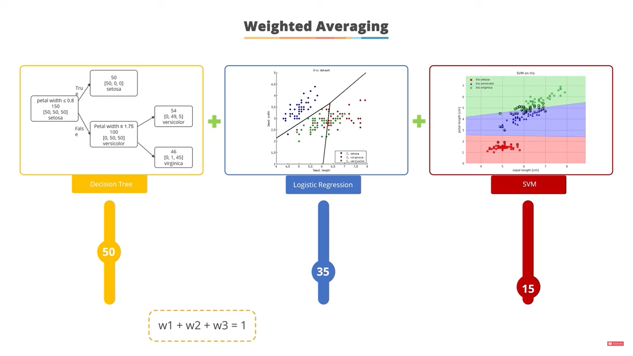
Weighted Averaging:
A weighted average ensemble is an extension of a model averaging ensemble where the contribution of each member to the final prediction is weighted by the performance of the model.
- The model weights are small positive values and the sum of all weights equals 1.

Slide 11
Bagging:
Bagging or bootstrap aggregation reduces the variance of an estimate by taking the mean of multiple estimates.
STEPS OF WORKING:
Create randomly sampled datasets of the original training data (bootstrapping).
2. Build and fit several classifiers to each of these diverse copies.
3. Take the average of all the predictions to make a final overall prediction.
Bagging is advantageous since weak base learners are combined to form a single strong learner that is more stable than single learners. It also eliminates any variance, thereby reducing the overfitting of models.

Slide 12
Q. Why Random Forests are a good example of ensemble learning method?

Slide 13
Q. Why Random Forests are a good example of ensemble learning method?
Ans –
Random forest says that one can guess combined various decision trees to produce a more generalized model by reducing the notorious overfitting tendency of the decision trees.
Random forests are utilized to produce de-correlated decision trees.
It creates subsets of the features. Smaller trees are built using these subsets, creating tree diversity.

Slide 14
Boosting:
Boosting is a sequential process where the errors of the previous model are corrected by each subsequent model.
Boosting is a technique for changing weak learners into strong learners.
Each new tree is a fit on a modified version of the original dataset.
Boosting takes many forms, including gradient boosting, Adaptive Boosting (AdaBoost), and XGBoost (Extreme Gradient Boosting).
AdaBoost uses weak learners in the form of decision trees, which mostly include one split that is popularly known as decision stumps. AdaBoost’s main decision stump comprises observations carrying similar weights.
STEPS OF WORKING:
Train a classifier H1 that best classifies the data with respect to accuracy.
2. Identify regions where H1 produces errors, add weights to them, and produce an H2 classifier.
3. Aggregate those samples for which H1 gives a different result from H2 and produces an H3 classifier.

Slide 15
AdaBoost:
AdaBoost is one of the first boosting algorithm to be adapted in best practices.
It helps mixing multiple weak classifiers into one strong classifier.

Slide 16

Example:
Consider a scenario, where there are ‘+’ and ‘-’.
Task - Classify ‘+’ and ‘-’.

Slide 17
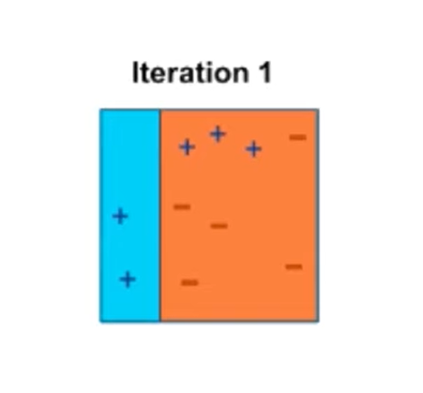
Working Of AdaBoost:
Step 1:
Assign equal weights to each data point and apply a decision stump to classify them as + (plus) and - (minus).
- Decision Stump - A decision stamp is a decision tree and uses a single attribute for splitting. for ex, Classification of Lemon and Lime on the basis of its color (a single attribute).
Decision stamp has generated a vertical plane at the left side to classify the + (plus).

Slide 18
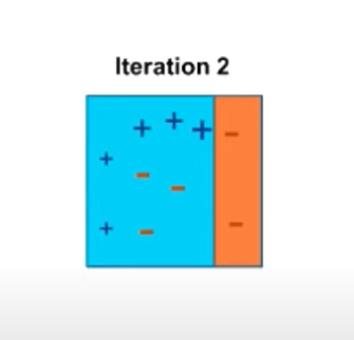
Step 2:
Now apply higher weights to incorrectly predicted three + (plus) and add another decision stump.
The size of the three incorrectly predicted + (plus) is made bigger than the rest of the data points.
The second decision stump will try to predict them correctly.
Now, vertical plane has classified three mis-classified + (plus) correctly.
Decision stump-2 has also caused mis-classification to three minus.

Slide 19
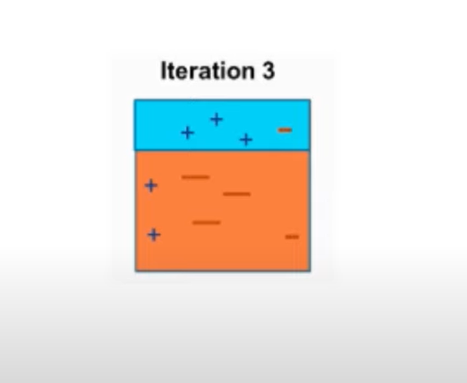
Step 3:
D3 adds higher weights to three - (minus).
A horizontal line is generated to classify + (plus) and - (minus) based on higher weight of mis-classified observation.
Step 4:
D1, D2, D3 are combined to form a strong prediction that has more complex rule than individual weak learners.

Slide 20
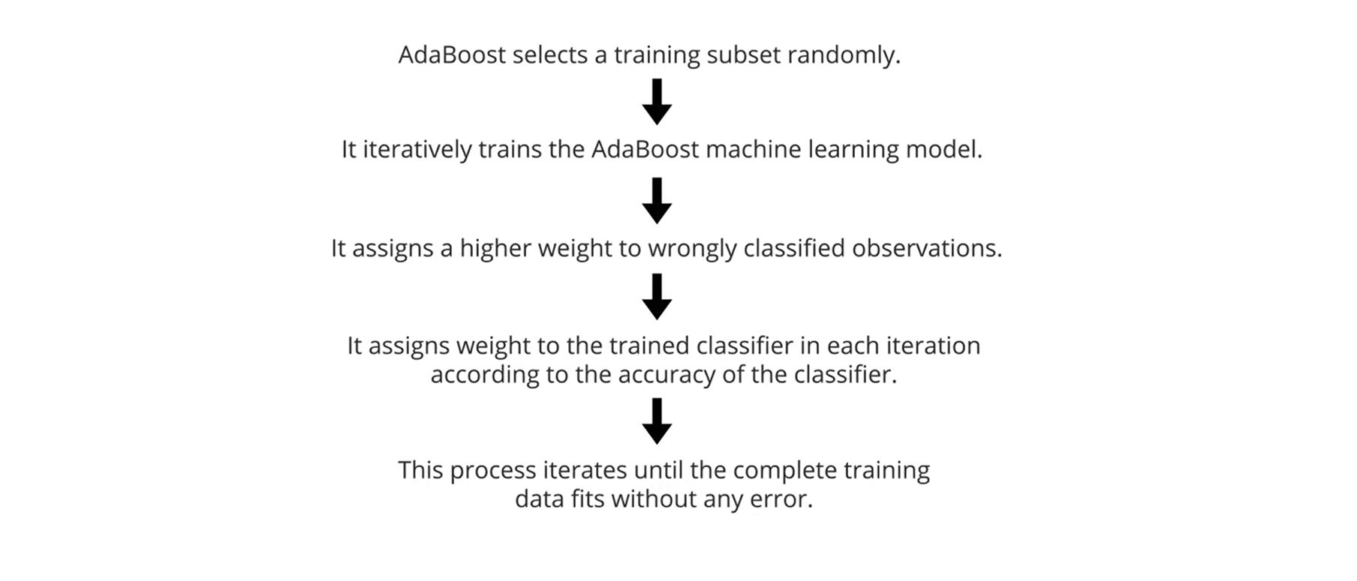
AdaBoost Algorithm Flowchart:

Slide 21
Stacking:
Stacking, another ensemble method, is often referred to as stacked generalization.
This technique works by allowing a training algorithm to ensemble several other similar learning algorithm predictions.
Stacking has been successfully implemented in regression, density estimations, distance learning, and classifications.
It can also be used to measure the error rate involved during bagging.

Slide 22
